Slide 1
Big Data
There were 5 exabytes of information created between the dawn of civilization through 2003, but that much information is now created every 2 days.” end.”

Slide 2
The Rise of Big Data
In the third century BC, Historians believed that the library of Alexandria was capable of holding all the data of human knowledge. But today there is such an amount of data available in the world, to give each human 320 times as much of it could be stored in Alexandria’s entire library. If all this information were placed on CDs and stacked up, it would form many pillars and reach to the moon twice.

Slide 3
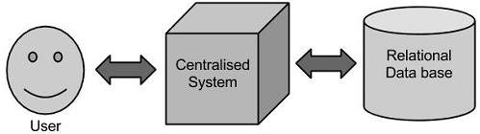
Traditional Approach
Traditional data refers to structured data which is collected and stored in formats like databases, spreadsheets, etc. Such data includes customer information, inventory records, financial statements, etc.
This data is stored in relational databases such as SQL and other traditional data analysis tools. It can be easily processed and manually analyzed using traditional methods to gain insight into business operations. It can also be used to create reports and visualizations, so it plays a vital role in making the right profitable decisions after understanding the trends and patterns in the data.

Slide 4
What is Big Data
Data which are very large in size is called Big Data.
By 2020, every person on earth will generate 1.7MB of data per second, sourced from over 50 billion devices connected to the internet. It is stated that almost 90% of today's data has been generated in the past 3 years
Big data, typically measured in petabytes or terabytes, materializes from three major sources, transactional data, machine data, and social data.
The term not only refers to the data, but also to the various frameworks, tools, and techniques involved.
It is not the quantity of data, which is essential. The important part is what any firm or organization can do with the data matters a lot. Analysis can be performed on big data for insight and predictions, which can lead to a better decision and reliable strategy in business moves.

Slide 5
Traditional Data | Big Data
It is usually a small amount of data that can be collected and analyzed using traditional methods easily. | It is usually a big amount of data that cannot be processed and analyzed easily using traditional methods.
It is usually structured data and can be stored in spreadsheets, databases, etc. | It includes semi-structured, unstructured, and structured data.
It often collects data manually. | It collects information automatically with the use of automated systems.
It usually comes from internal systems. | It comes from various sources such as mobile devices, social media, etc.
It consists of data such as customer information, financial transactions, etc. | It consists of data such as images, videos, etc.
Analysis of traditional data can be done with the use of primary statistical methods. | Analysis of big data needs advanced analytics methods such as machine learning, data mining, etc.
Traditional methods to analyze data are slow and gradual. | Methods to analyze big data are fast and instant.

Slide 6
It generates data after the happening of an event. | It generates data every second.
It is typically processed in batches. | It is developed and processed in real-time.
It is limited in its value and insights. | It provides valuable insights and patterns for good decision-making.
It contains reliable and accurate data. | It may contain unreliable, inconsistent, or inaccurate data because of its size and complexity.
It is used for simple and small business processes. | It is used for complex and big business processes.
It does not provide in-depth insights. | It provides in-depth insights.
It is easy to secure and protect than big data because of its small size and simplicity. | It is harder to secure and protect than traditional data because of its size and complexity.
It requires less time and money to store traditional data. | It requires more time and money to store big data.
It can be stored on a single computer or server. | It requires distributed storage across numerous systems.
It is less efficient than big data. | It is more efficient than traditional data.
It can be managed in a centralized structure easily. | It requires a decentralized infrastructure to manage the data.

Slide 7
The Concept of Big Data and Big Data Analytics
Big Data comes to play for a large and complex data sets which can be considered from multiples of terabytes to exabytes. This huge and complex data sets cannot be manipulated by common traditional data management applications like RDBMS.
Big Data Analytics has been applied on various Sectors like Media, Education, Healthcare, Manufacturing, various Government and non-government sectors and also it has been used in complex analytics, real-time fraud management, traffic management, customer-centric analytics and many more.
Monitoring payment patterns and analyzing them against historical customer activity to detect fraud in real time

Slide 8
Types of Big Data Analytics
There are four types of Big Data Analytics
Predictive Analytics
This analytics is basically a prediction based analytics. Predictive Analytics works on a data set and determines what can be happened. It basically analyses past data sets or records to provide a future prediction.

Slide 9
Prescriptive Analytics
Prescriptive Analytics works on a data set and determines what actions needs to be taken. This is a valuable analysis but not used widely. Many of the health care sectors used this analysis on the top of various activities to manage their business activities.
Descriptive Analytics
Descriptive Analytics actually analyze the past and determines what actually happens and why. It also helps to visualize this analysis in the dashboard may be in the form of graphical representation or in some other format.
Diagnostic Analytics
Diagnostic Analytics executes on current data sets. It is used to do analysis based on incoming real-time data sets. Many of the systems like business intelligence tools use this analysis to create real-time dashboards and reports.

Slide 10
Big Data Analytics Examples
Fraud Management Report which is generally used in Banking Sectors to find the fraud transactions, hacking, unauthorized access to the account and so on.
Live Tracking Report which is generally used by Transport Sectors such as Meru, Ola, Uber, and Mega to track the vehicles, customer’s requests, payment management, emergency alert and to find the daily needs and revenues and so on.
Big Data Analytics Examples also played a vital role in many disaster situations. In the year April 2015 earthquake killed and also injured many peoples in Nepal. In this situation, North Carolina-based SAS has been developed by Analytics which has been played a massive role in rescue and relief operation.
Google Analytics report where we can get how many user’s visit counts, from which location the user is from, from which device the site is accessing and so on.

Slide 11
Big data in marketing and advertising
Netflix and big data
Netflix, a global streaming service, recommends material to its subscribers using big data analytics. Netflix predicts what users would want to watch next based on their viewing histories, ratings, and searches. This data-driven strategy not only keeps viewers interested but also adds considerably to client retention, demonstrating the value of big data in the entertainment business.

Slide 12
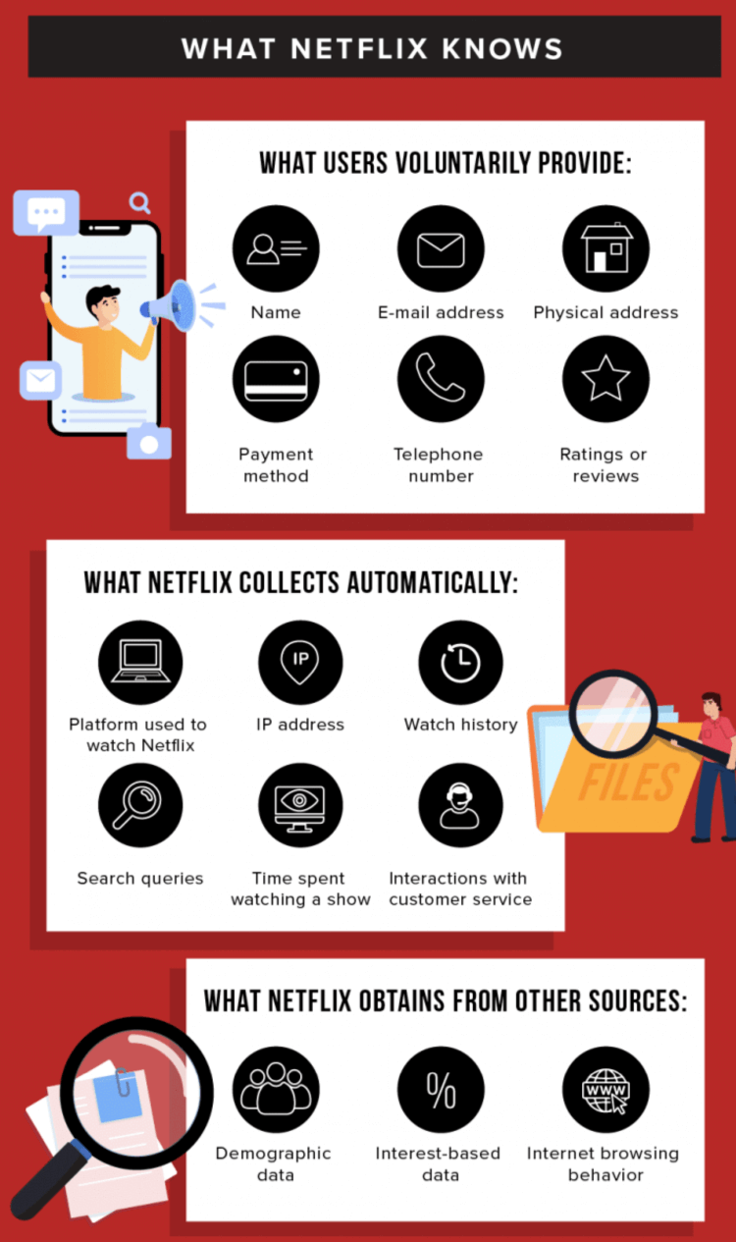

Slide 13
Starbucks: Optimizing Store Locations : Starbucks, the well-known coffee brand, uses big data analytics to identify the best shop sites. Starbucks chooses good locations for new stores by evaluating demographic data, foot traffic patterns, and local preferences. This strategic strategy assures improved consumer traffic, revenue, and brand awareness, proving the importance of big data analytics in retail expansion.

Slide 14
Amazon and big data
Much like Netflix, Amazon collects vast amounts of data on its users. They track what users buy, how often (and for how long) they stay online, and even things like product reviews (useful for sentiment analysis).
Amazon can even guess people’s income based on their billing address. By compiling all this data across millions of users, Amazon can create highly-specialized segmented user profiles.
Using predictive analytics, they can then target their marketing based on users’ browsing habits. This is used for suggesting what you might want to buy next, but also for things like grouping products together to streamline the shopping experience.

Slide 15
Airbnb:
Dynamic Pricing: Airbnb, the worldwide hospitality platform, implements dynamic pricing tactics using big data analytics. Airbnb modifies lodging costs in real time by assessing factors such as demand, seasonality, local events, and customer behavior. This data-driven pricing approach maximizes revenue for hosts while offering competitive costs to visitors, demonstrating the power of big data in the sharing economy.

Slide 16
General Electric: Predictive Maintenance : General Electric (GE) uses big data analytics to improve the operation of industrial machinery. GE anticipates when equipment will break and schedules maintenance before problems arise by collecting and analyzing data from sensors implanted in machines. This predictive maintenance technique decreases downtime, lowers operating costs, and preserves the longevity of important equipment, demonstrating big data’s promise in the industrial industry.

Slide 17
SELF-DRIVING VEHICLES: BIG DATA BEHIND THE WHEEL
All the information generated by a self-driving car's sensors and the information received from satellites and sensors in the environment amounts to between 50 and 70 terabytes of data every eight hours of driving. It is enough to think that one terabyte can store 250 HD movies to understand the magnitude of the data processed.
Structuring all this data from cameras and other sensors requires the use of big data. And not just for day-to-day driving but also for assessing driving habits and urban planning. In addition to Tesla, companies such as Waymo, GM Cruise, or Argo AI are investing billions of dollars in this technology.

Slide 18
McDonald’s and big data
Big data isn’t just used to tailor online experiences. A good example of this is McDonald’s, who use big data to shape key aspects of their offering offline, too. This includes their mobile app, drive-thru experience, and digital menus.
With its own app, McDonald’s collects vital information about user habits. This lets them offer tailored loyalty rewards to encourage repeat business. But they also collect data from each restaurant’s drive-thru, allowing them to ensure enough staff is on shift to cover demand. Finally, their digital menus offer different options depending on factors such as the time of day, if any events are taking place nearby, and even the weather.
So, if it’s a hot day, expect to be offered a McFlurry or a cold drink…not a spicy burger!

Slide 19
Byte Comparison Table
Metric | Value | Bytes
Byte (B) | 1 | 1
Kilobyte (KB) | 1,024¹ | 1,024
Megabyte (MB) | 1,024² | 1,048,576
Gigabyte (GB) | 1,024³ | 1,073,741,824
Terabyte (TB) | 1,024⁴ | 1,099,511,627,776
Petabyte (PB) | 1,024⁵ | 1,125,899,906,842,624
Exabyte (EB) | 1,024⁶ | 1,152,921,504,606,846,976
Zettabyte (ZB) | 1,024⁷ | 1,180,591,620,717,411,303,424
Yottabyte (YB) | 1,024⁸ | 1,208,925,819,614,629,174,706,176

Slide 20
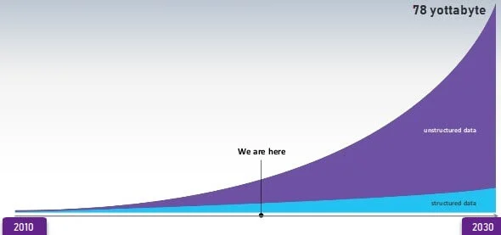
Data growth prediction

Slide 21
Examples of Big Data
Daily we upload millions of bytes of data. 90 % of the world’s data has been created in last two years.
Walmart handles more than 1 million customer transactions every hour.
Facebook stores, accesses, and analyzes 30+ Petabytes of user generated data.
230+ millions of tweets are created every day.
More than 5 billion people are calling, texting, tweeting and browsing on mobile phones worldwide.
YouTube users upload 48 hours of new video every minute of the day.
Amazon handles 15 million customer click stream user data per day to recommend products.
294 billion emails are sent every day. Services analyses this data to find the spams.
Modern cars have close to 100 sensors which monitors fuel level, tire pressure etc. , each vehicle generates a lot of sensor data.

Slide 22
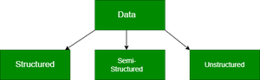
TYPES OF BIG-DATA
Big Data is generally categorized into three different varieties.

Slide 23
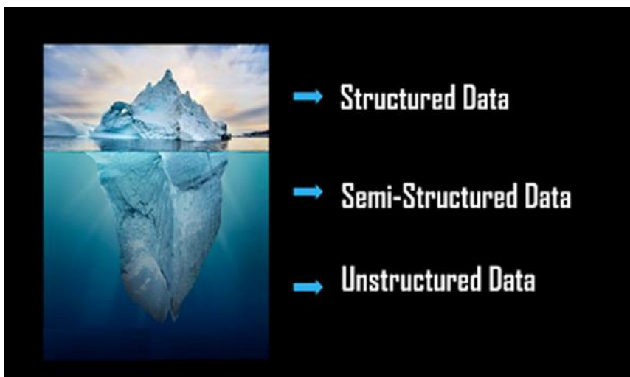

Slide 24
Structured Data
Structured data can be crudely defined as the data that resides in a fixed field within a record.
It is type of data most familiar to our everyday lives. for ex: birthday,address
A certain schema binds it, so all the data has the same set of properties. Structured data is also called relational data. It is split into multiple tables to enhance the integrity of the data by creating a single record to depict an entity. Relationships are enforced by the application of table constraints.
The business value of structured data lies within how well an organization can utilize its existing systems and processes for analysis purposes.

Slide 25
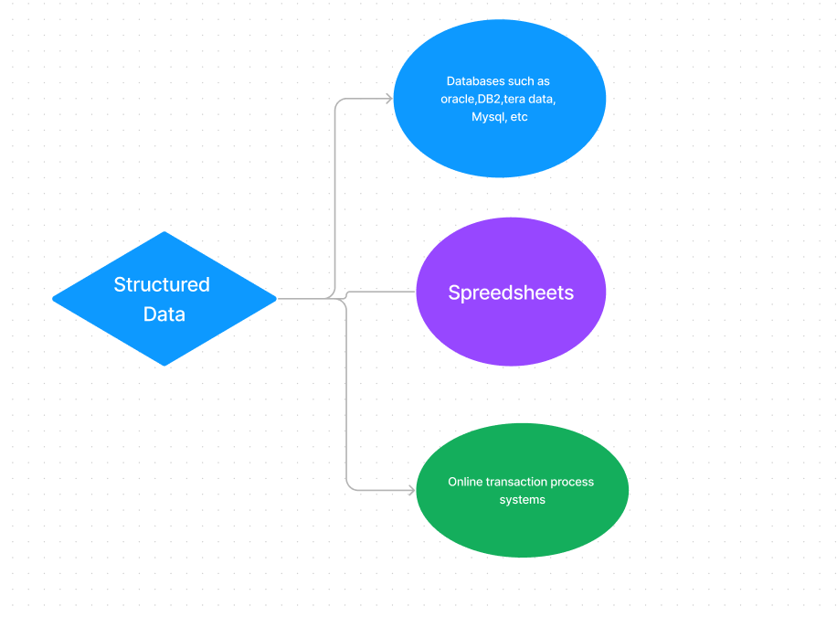
Employee_ID | Employee_Name | Gender | Department | Salary_In_lacs
2365 | Rajesh Kulkarni | Male | Finance | 650000
3398 | Pratibha Joshi | Female | Admin | 650000
7465 | Shushil Roy | Male | Admin | 500000
7500 | Shubhojit Das | Male | Finance | 500000
7699 | Priya Sane | Female | Finance | 550000

Slide 26
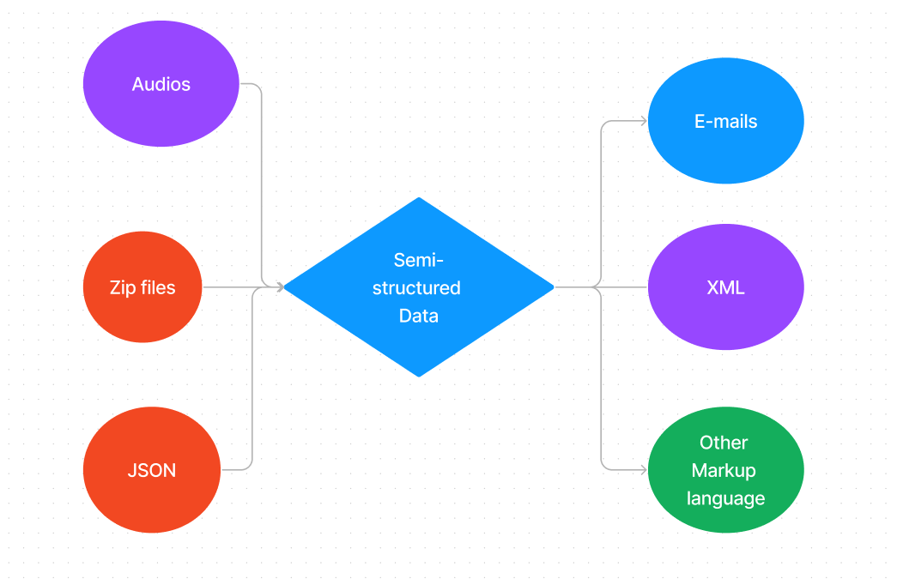
Semi-Structured Data
Semi-Structured Data can be considered as another form of Structured Data. It inherits a few properties of Structured Data, but the major part of this kind of data fails to have a definite structure and also, it does not obey the formal structure of data models such as an RDBMS.
Example: Comma Separated Values(CSV) File.

Slide 27
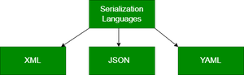
Data Serialization Languages
Software developers use serialization languages to write memory-based data in files, transit, store, and parse. The sender and the receiver don’t need to know about the other system. As long as the same serialization language is used, the data can be understood by both systems comfortably. There are three predominantly used Serialization languages.

Slide 28
XML stands for eXtensible Markup Language. It is a text-based mark-up language designed to store and transport data. XML parsers can be found in almost all popular development platforms. It is human and machine-readable. XML has definite standards for schema, transformation, and display. It is self-descriptive.
XML
<ProgrammerDetails>
<FirstName>Jane</FirstName>
<LastName>Doe</LastName>
<CodingPlatforms>
<CodingPlatform Type="Fav">GeeksforGeeks</CodingPlatform>
<CodingPlatform Type="2ndFav">Code4Eva!</CodingPlatform>
<CodingPlatform Type="3rdFav">CodeisLife</CodingPlatform>
</CodingPlatforms>
</ProgrammerDetails>
XML expresses the data using tags (text within angular brackets) to shape the data (for ex: FirstName) and attributes (For ex: Type) to feature the data. However, being a verbose and voluminous language, other formats have gained more popularity.

Slide 29
JSON (JavaScript Object Notation) is a lightweight open-standard file format for data interchange. JSON is easy to use and uses human/machine-readable text to store and transmit data objects.
Javascript
{
"firstName": "Jane",
"lastName": "Doe",
"codingPlatforms": [
{ "type": "Fav", "value": "Geeksforgeeks" },
{ "type": "2ndFav", "value": "Code4Eva!" },
{ "type": "3rdFav", "value": "CodeisLife" }
]
}
This format isn’t as formal as XML. It’s more like a key/value pair model than a formal data depiction. Javascript has inbuilt support for JSON. Although JSON is very popular amongst web developers, non-technical personnel find it tedious to work with JSON due to its heavy dependence on JavaScript and structural characters (braces, commas, etc.)

Slide 30
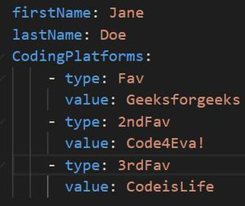
YAML– YAML is a user-friendly data serialization language. Figuratively, it stands for YAML Ain’t Markup Language. It is adopted by technical and non-technical handlers all across the globe owing to its simplicity. The data structure is defined by line separation and indentation and reduces the dependency on structural characters. YAML is extremely comprehensive and its popularity is a result of its human-machine readability.

Slide 31
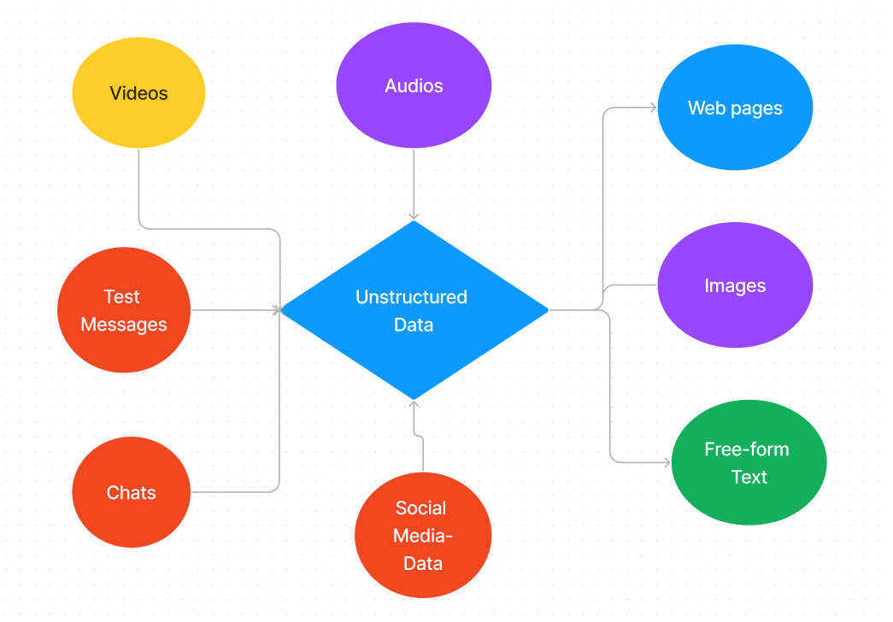
Unstructured Data
Unstructured Data is completely a different type of which neither has a structure nor obeys to follow the formal structural rules of data models. It does not even have a consistent format and it found to be varying all the time. But, rarely it may have information related to data and time.
Example: Audio Files, Images etc

Slide 32
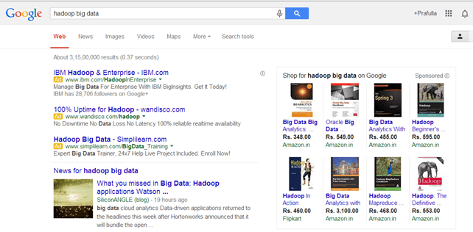
Examples Of Un-structured Data
The output returned by ‘Google Search’

Slide 33
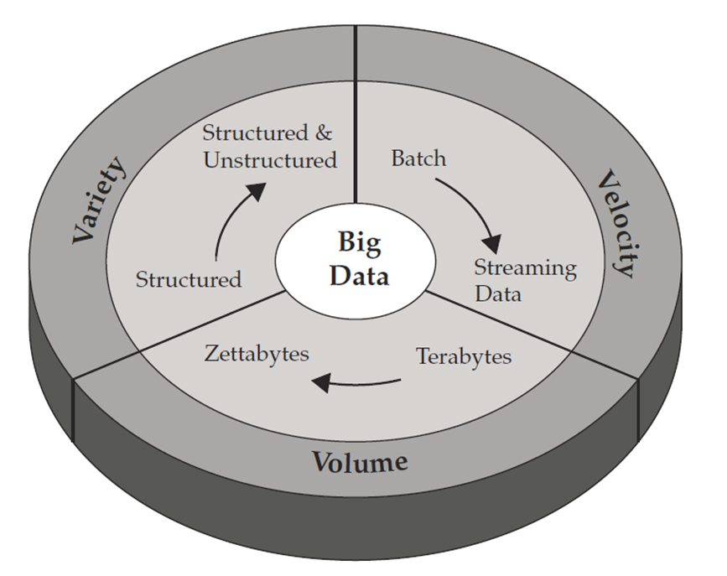
Characteristics Of Big Data
The following are known as “Big Data Characteristics”.
Volume: TB
Velocity: TB/sec. Speed of creation or change
Variety: Type (Text, audio, video, images, geospatial, ...)

Slide 34
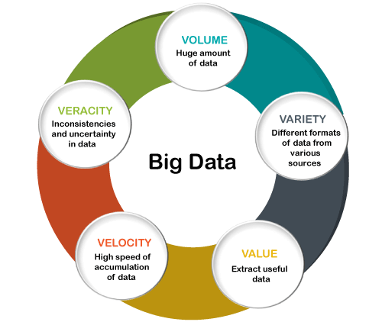
5V
In the early part of this century, big data was only talked about in terms of the three V's -- volume, velocity and variety.
Over time, two more V's (value and veracity) have been added to help data scientists be more effective in articulating and communicating the important characteristics of big data.

Slide 35
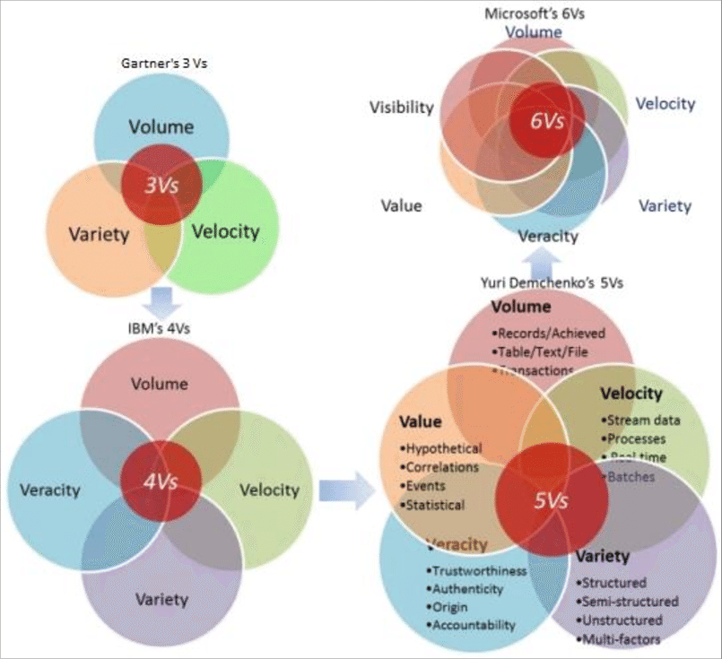

Slide 36
Characteristics of Big Data | Details
Volume | Organizations have to constantly scale their storage solutions since big data requires a large amount of space to be stored.
Velocity | Since big data is being generated every second, organisations need to respond in real time to deal with it.
Variety | Big data comes in a variety of forms. It could be structured or unstructured, or even in different formats such as text format, videos, images, and more.
Veracity | Big data, as large as it is, can contain wrong data too. Uncertainty of data is something organisations have to consider while dealing with big data.
Value | Just collecting big data and storing it is of no consequence unless the data is analyzed and a useful output is produced.

Slide 37
Volume
The name Big Data itself is related to a size which is enormous. Size of data plays a very crucial role in determining value out of data. Also, whether a particular data can actually be considered as a Big Data or not, is dependent upon the volume of data. Hence, ‘Volume’ is one characteristic which needs to be considered while dealing with Big Data solutions.
Facebook can generate approximately a billion messages, 4.5 billion times that the "Like" button is recorded, and more than 350 million new posts are uploaded each day. Big data technologies can handle large amounts of data.

Slide 38
Volume:
Volume means “How much Data is generated”. Now-a-days, Organizations or Human Beings or Systems are generating or getting very vast amount of Data say TB(Tera Bytes) to PB(Peta Bytes) to Exabyte(EB) and more.
Data Volume
• 44x increase from 2009 to 2020
• From 0.8 zettabytes to 35zb
Some examples: –
Google processes 20 PB a day (2008)
Facebook has 2.5 PB of user data + 15 TB/day (4/2009)
Facebook can generate approximately a billion messages, 4.5 billion times that the "Like" button is recorded, and more than 350 million new posts are uploaded each day. Big data technologies can handle large amounts of data.

Slide 39
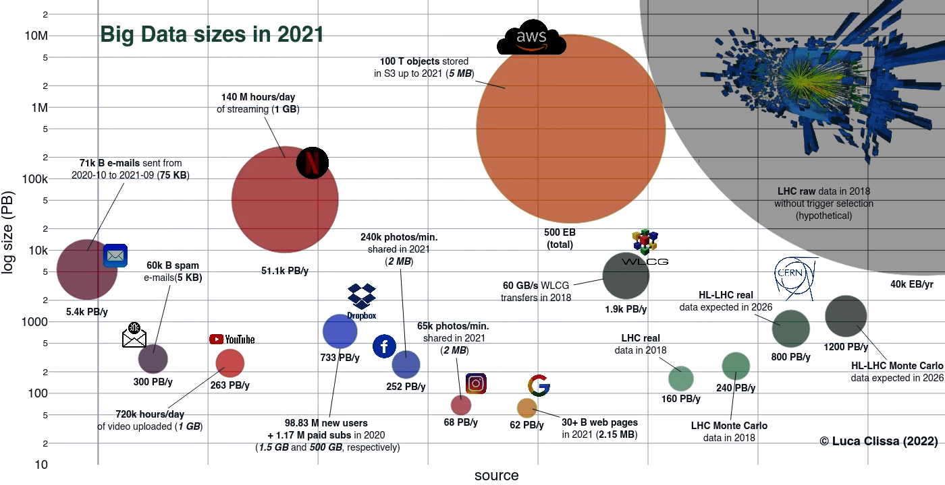

Slide 40
Velocity:
In big data, Velocity demonstrate two things mainly,
(1) Speed of growth of data (2) Speed of transmission of data
Taking the example of Meta, the 350 million images added to its servers each day determine the velocity.7 Oct 2022
Data is begin generated fast and need to be processed fast
Online Data Analytics
Late decisions -> missing opportunities.
Examples
E-Promotions: Based on your current location, your purchase history,
what you like -> send promotions right now for store next to you
Healthcare monitoring: sensors monitoring your activities and body -> any abnormal measurements require immediate reaction
Big data grows fast. According to Zettaspere, there are around 3,400,000 emails, 4,595 SMS, 740,741 WhatsApp messages, almost 69,000 Google searches, 55,000 Facebook posts, and 5,700 tweets made per minute.
In the year 2000, Google was receiving 32.8 million searches per day. As for 2018, Google was receiving 5.6 billion searches per day!

Slide 41
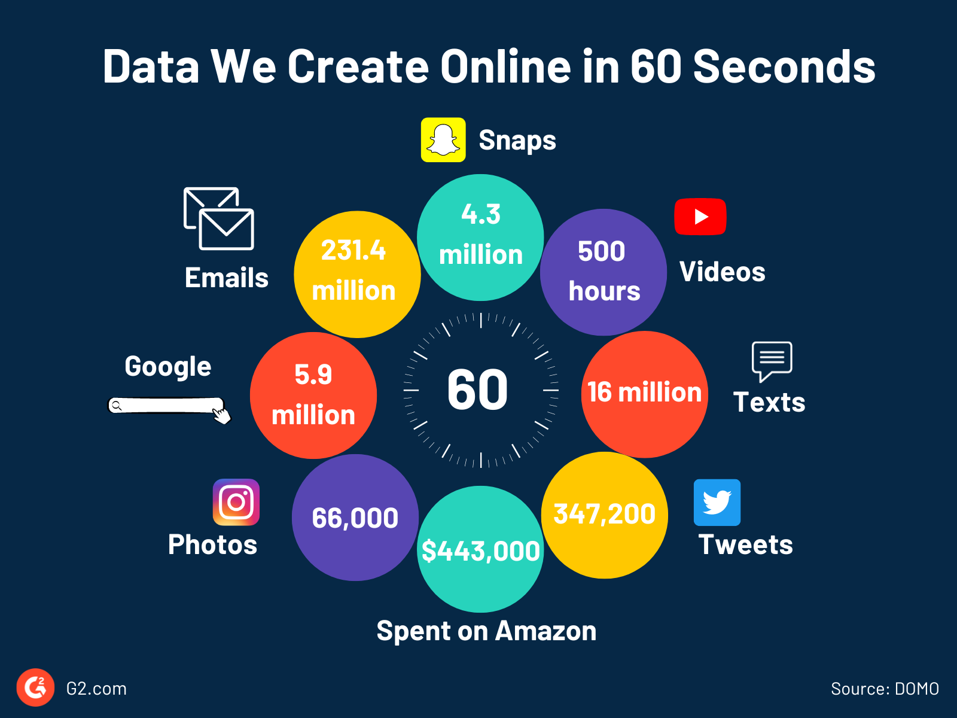

Slide 42
An example of data velocity
Using real-time alerting, Walmart sales analysts noted that a particular, rather popular, Halloween novelty cookie was not selling in two stores. A quick investigation showed that, due to a stocking oversight, those cookies hadn’t been put on the shelves. By receiving automated alerts, Walmart was quickly able to rectify the situation and save its sales.

Slide 43
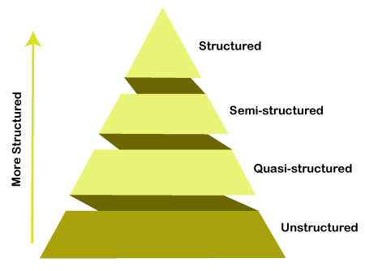

Variety:
Compared to the traditional data like phone
numbers and addresses, the latest trend of data is in the form of photos, videos, and audios and many more,
making about 80% of the data to be completely unstructured

Slide 44
Veracity
Veracity is the accuracy, meaningfulness and confirmation of true data.
It is very difficult to extract correct information/data from the huge set of various types of data.
Veracity can be a challenge on social media, where information can be incorrect or misleading.
Veracity is very important term in processing of big data because, any inaccurate, fake and meaningless data leads to damage in revenue or required results.
Therefore it is necessary to extract real data from big data.

Slide 45
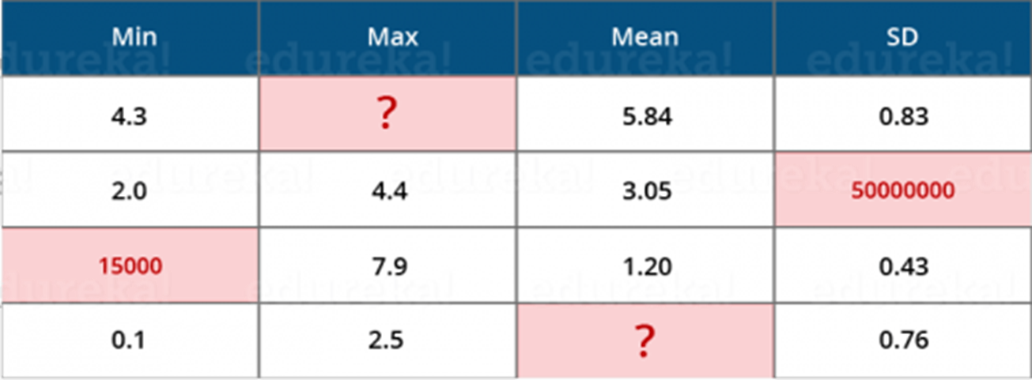
Veracity
The word veracity originates from verax, which means ‘speaking truly’, and veracity represents “conformity with truth or fact”.
“Veracity refers to the data in doubt or uncertainty of data available due to data inconsistency and incompleteness. It is evident that few values are missing in the table. Also, a few values are hard to accept, for example – 15000 minimum value in the 3rd row, it is not possible. This inconsistency and incompleteness is Veracity.

Slide 46
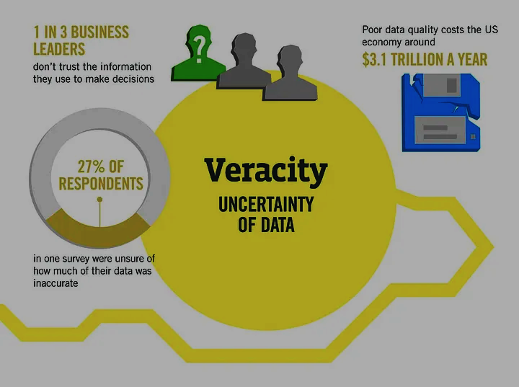

Slide 47
Veracity
Data available can sometimes get messy and maybe difficult to trust. With many forms of big data, quality and accuracy are difficult to control like Twitter posts with hashtags, abbreviations, typos and colloquial speech. The volume is often the reason behind for the lack of quality and accuracy in the data.
Due to uncertainty of data, 1 in 3 business leaders don’t trust the information they use to make decisions.
It was found in a survey that 27% of respondents were unsure of how much of their data was inaccurate.
Poor data quality costs the US economy around $3.1 trillion a year

Slide 48
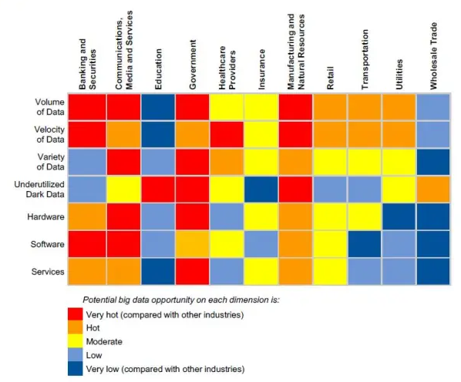

Slide 49
Value
Value refers to the usefulness and importance of the data and how they can be used to gain benefits and insights. The value of the data lies in how they can be used to improve decision-making, optimize processes, and generate new opportunities.
Extracting value implies implementing advanced analytical tools and machine learning techniques to discover hidden insights and opportunities.
Netflix, for example, uses Big Data to analyze user preferences and recommend movies and series, creating value through a better user experience.
Amazon uses Big Data analytics to optimize its logistics and supply chain, resulting in faster delivery and better customer service.

Slide 50
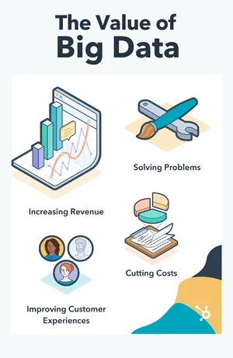

Slide 51
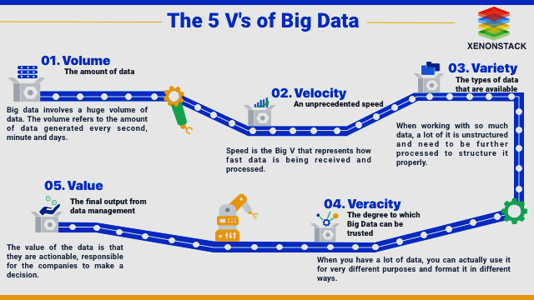

Slide 52
Big Data – Vulnerability
Big data systems contain complex and sensitive data, making them prime targets of cyber attacks. Criminals can exploit big data systems to gain unauthorized access to data, disrupt operations, or even cause financial damage.
Gain unauthorized access to data
Disrupt operations
Cause financial damage
Data vulnerability has three categories:
The data itself
The systems where the data is stored
The networks where data moves back and forth

Slide 53
Benefits of using Big Data
There are endless services offered by Big Data to the current market. If exploited properly, Big Data can lead to substantial results.
Better decision making
Greater innovations
Improvement in education sector
Product price optimization
Recommendation engines
Life-Saving application in the healthcare industry

Slide 54
Big Data Challanges
1990 could store 1370 MB of data and had a transfer speed of 4.4 MB/s, so you could read all the data from a full drive in around five minutes
If one terabyte drives are the norm, but the transfer speed is around 100 MB/s, so it takes more than two and a half hours to read all the data off the disk.
This is a long time to read all data on a single drive—and writing is even slower.

Slide 55
Challenges with Big Data
Quick Data Growth
Data growing at such a quick rate is making it a challenge to find insights from it. There is more and more data generated every second from which the data that is actually relevant and useful has to be picked up for further analysis.
Storage
Such a large amount of data is difficult to store and manage by organizations without appropriate tools and technologies.
Syncing Across Data Sources
This implies that when organizations import data from different sources the data from one source might not be up to date as compared to the data from another source.

Slide 56
Security
Large amounts of data in organizations can easily become a target for advanced persistent threats, so here lies another challenge for organizations to keep their data secure by proper authentication, data encryption, etc.
Unreliable Data
We can’t deny the fact that big data can’t be 100 percent accurate. It might contain redundant or incomplete data, along with contradictions.
Miscellaneous Challenges
These are some other challenges that come forward while dealing with big data, like the integration of data, skill and talent availability, solution expenses, and processing a large amount of data in time and with accuracy so that the data is available for data consumers whenever they need it.

Slide 57
Big Data Frameworks
Apache Hadoop is a framework that allows parallel data processing and distributed data storage.
Apache Spark is a general-purpose distributed data processing framework.
Apache Kafka is a stream processing platform.
Apache Cassandra is a distributed NoSQL database management system.

Slide 58
Big Data Technologies
Operational Big Data: comprises of data on systems such as MongoDB, Apache Cassandra, or CouchDB, which offer equipped capabilities in real-time for large data operations.
Analytical Big Data: comprises systems such as MapReduce, BigQuery, Apache Spark, or Massively Parallel Processing (MPP) database, which offer analytical competence to process complex analysis on large datasets.

Slide 59
NoSQL database
When people use the term “NoSQL database”, they typically use it to refer to any non-relational database. Some say the term “NoSQL” stands for “non SQL” while others say it stands for “not only SQL”. Either way, most agree that NoSQL databases are databases that store data in a format other than relational tables.

Slide 60
MongoDB
As a definition, MongoDB is an open-source database that uses a document-oriented data model and a non-structured query language. It is one of the most powerful NoSQL systems and databases around, today.
Example of a document database in MongoDB
{_id:
name: “Thomson”,
Age: 22,
Address: {{street: “124 church street”,
city: “brooklyn”,
state: “NY”,
zip: “13400”,
country: “US”}}
}

Slide 61
R Programming
R is an open-source programming language and is one of the most comprehensive statistical analysis languages.

Slide 62
Data Warehouse
Consider a multinational company with branches in India, Australia, and Japan.
Each branch maintains its own Local Database where all customer data is stored. These databases typically use conventional RDBMS platforms like Oracle, MySQL, or SQL Server. Customer data is added to these databases on a daily basis.
Periodically, whether quarterly, half-yearly, or yearly, the organization needs to analyze this accumulated data for business development purposes. Now, every quarterly, half-yearly or yearly basis, the organization wants to analyze this data for business development.
To do the same, the organization will collect all this data from multiple sources and then put it together in one place and this place is called “Data Warehouse”.

Slide 63
Extraction: Data is extracted from diverse sources, such as databases, spreadsheets, cloud services, and APIs. This data can be structured (like relational databases) or unstructured (like social media feeds).
Transformation: Data is cleansed, enriched, and transformed to meet specific business requirements. This involves data validation, aggregation, normalization, and sometimes even data imputation.
Loading: The transformed data is loaded into a centralized data repository, which is typically a data warehouse or data lake. This step enables easy access and analysis.

Slide 64
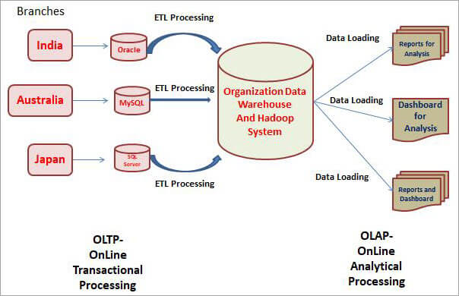

Slide 65
Databases that are maintained locally and used for transactional purposes are called OLTP i.e. Online Transaction Processing. The day to day transactions will be stored here and updated immediately and that’s why we called them OLTP System.
We use Traditional Databases, we have multiple tables and there are relationships, thus everything is systematically planned as per the database. We are not using this data for analytical purposes. Here, we can use classical RDMBS databases like Oracle, MySQL, SQL Server, etc.

Slide 66
We come to the Data Warehouse part, we use Teradata or Hadoop Systems, which are also a kind of database but the data in a DataWarehouse is usually utilized for analytical purposes and is called OLAP or Online Analytical Processing.

